Slide 1









Whiteboardmaths.com
7
2
1
5
© 2004 All rights reserved

Slide 2
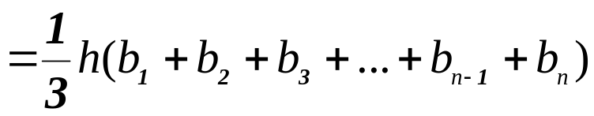
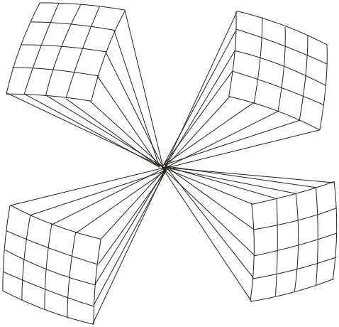
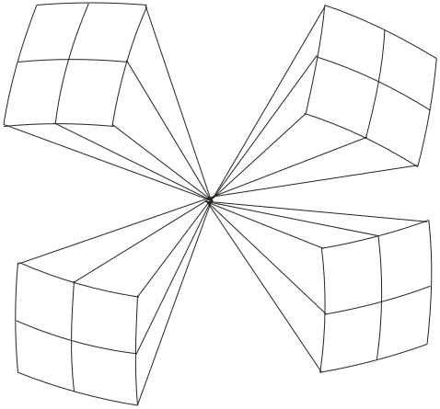


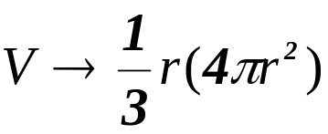

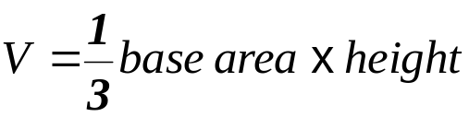
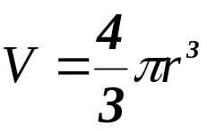
The Volume of a Sphere
The formulas for the surface area of a sphere and volume of a pyramid can be used to help derive the formula for the volume of a sphere. Imagine the sphere to be composed of square - based pyramids with their bases laying on the surface and their vertices meeting at the centre. By allowing the base areas of the pyramids to become infinitely small and the number of pyramids to become infinitely large, the total base area of all the pyramids tends to 4πr². The height of each pyramid will get closer to the radius of the sphere. Therefore the total volume of all the pyramids approaches ever more closely, the volume of the sphere.
Filling a sphere with increasing numbers of smaller and smaller pyramids.
SA = 4πr²

Slide 3
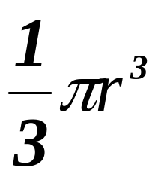
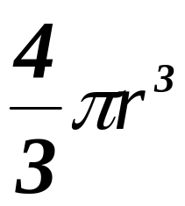
Archimedes did not have the advantage of a sophisticated algebra like we use today. He had to express relationships in terms of simpler geometric shapes. For him the volume of a sphere was equal to the volume of 4 cones of the same diameter and height equal to the radius of the sphere.

Slide 4
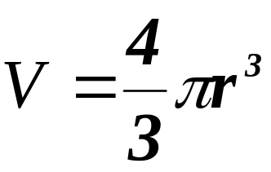

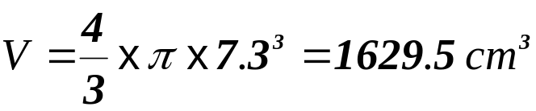
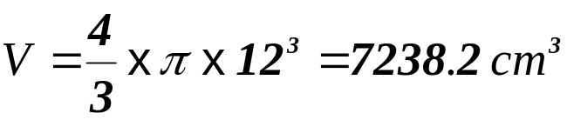
Example Questions: Calculate the volume of the spheres below. (to 1 dp)
1
2
7.3 cm
12 cm

Slide 5
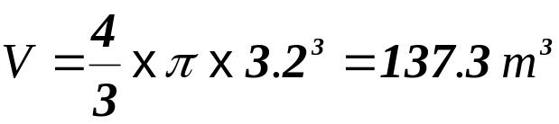
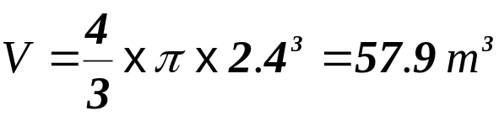
Questions: Calculate the volume of the spheres below. (to 1 dp)
1
2
3.2 m
2.4 m

Slide 6
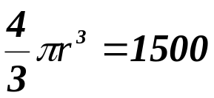



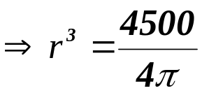
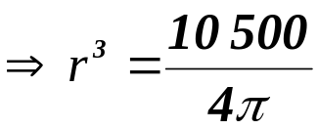
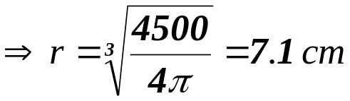
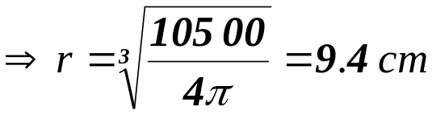
Example Questions: Calculate the radii of the spheres shown below. (to 1 dp)
1
2
V = 1500 cm³
V = 3500 cm³

Slide 7
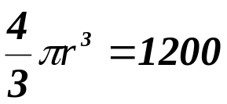
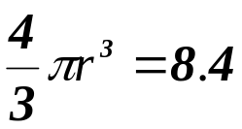


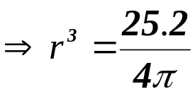
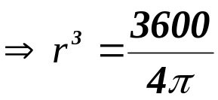
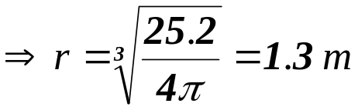
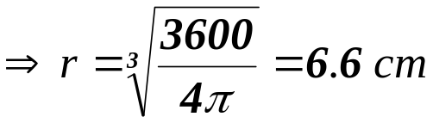
Questions: Calculate the radii of the spheres shown below. (to 1 dp)
2
1
V = 8.4 m³
V = 1200 cm³

Slide 8
Worksheet 1
Example Questions: Calculate the volume of the spheres below. (to 1 dp)
1
2
7.3 cm
12 cm

Slide 9
Worksheet 2
Questions: Calculate the volume of the spheres below. (to 1 dp)
1
2
3.2 m
2.4 m

Slide 10
Worksheet 3
Example Questions: Calculate the radii of the spheres shown below. (to 1 dp)
1
2
V = 1500 cm³
V = 3500 cm³

Slide 11
Worksheet 4
Questions: Calculate the radii of the spheres shown below. (to 1 dp)
1
2
V = 8.4 m³
V = 1200 cm³

Slide 12
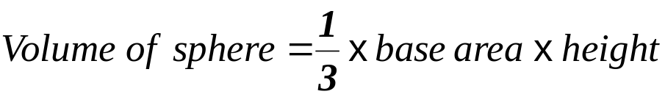
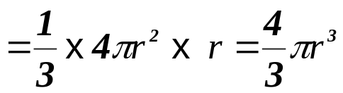
Alternate to slide 1
The volume of a Sphere
The formulas for the surface area of a sphere and volume of a pyramid can be used to help derive the formula for the volume of a sphere. Imagine the sphere to be composed of square - based pyramids with their bases laying on the surface and their vertices meeting at the centre. By allowing the base areas of the pyramids to become infinitely small and the number of pyramids to become infinitely large, the total base area of all the pyramids = 4πr². The height of each pyramid is equal to the radius of the sphere. Therefore the total volume of all the pyramids approaches, ever more closely, the volume of the sphere.

